Slide 1

Microprocessor Systems
Lab7-1 IR Distance Measuring Sensor-GP2Y0A51SK0F
& Analog Digital Convertor-MCP3202
Prof. Ren-Shuo Liu
NTHU EE

Slide 2
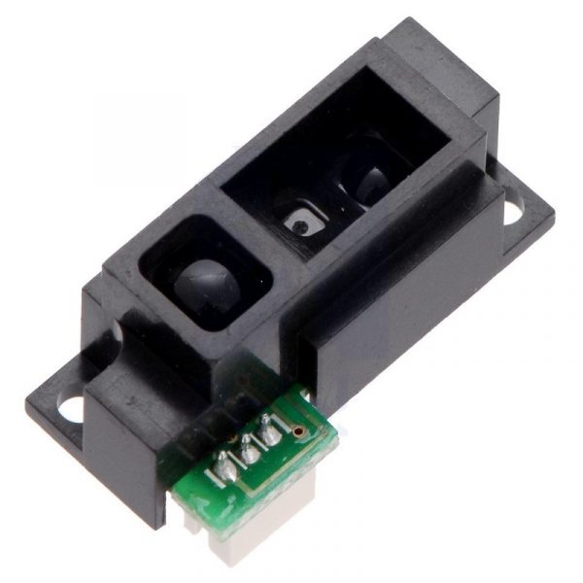
Introduction
GP2Y0A51SK0F is a distance measuring sensor unit.
Composed of an integrated combination of
  PSD (position sensitive detector)
  IR-LED (infrared emitting diode)
  Signal processing circuit

Slide 3
Features
Short measuring cycle (16.5ms)
Distance measuring range : 2 to 15 cm
Compact size (27.0 × 10.8 × 12.0mm)
Analog output type

Slide 4
IR Sensors Key Applications
TVs, computers, laptops
Distance measurement (in this lab)
Security systems such as surveillance, burglar alarms, etc.
Monitoring and control applications

Slide 5
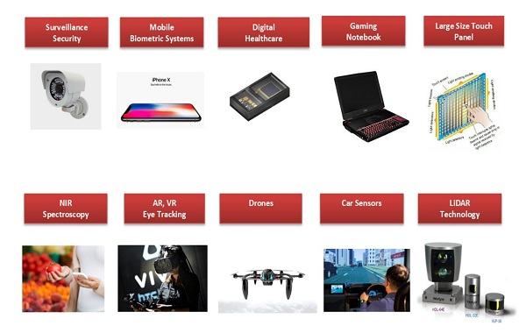
IR Sensors Key Applications

Slide 6
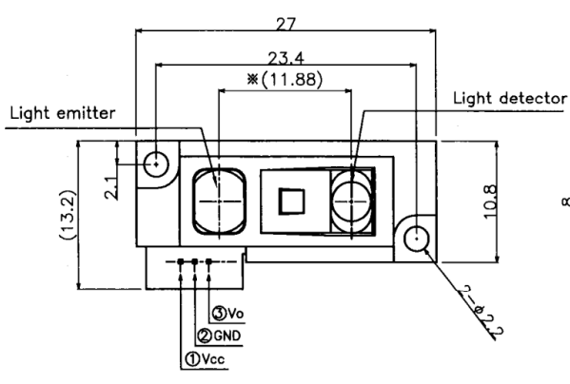
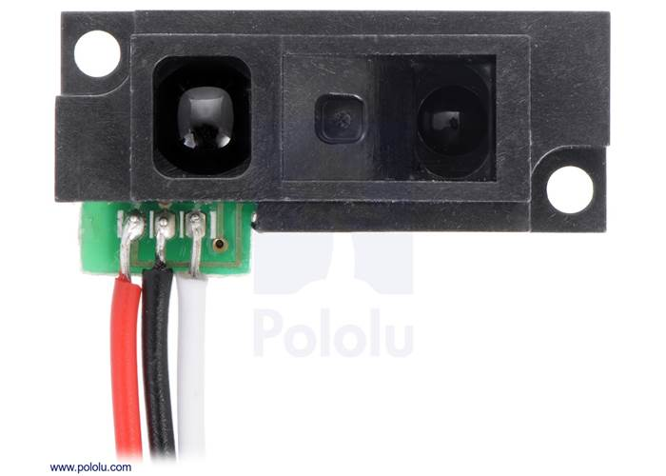
Appearance
LED
PSD
An IR LED emitter lens that emits a light beam.
A position-sensible photodetector (PSD) where the reflected beam will fall onto.

Slide 7
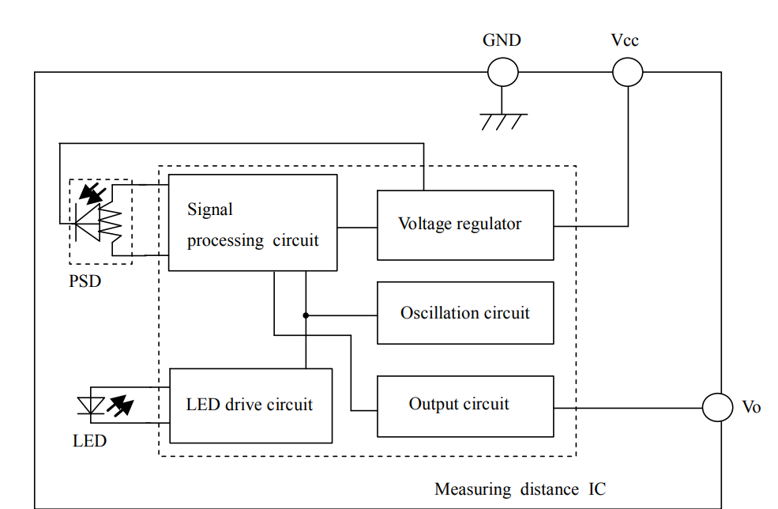
Block Diagram

Slide 8
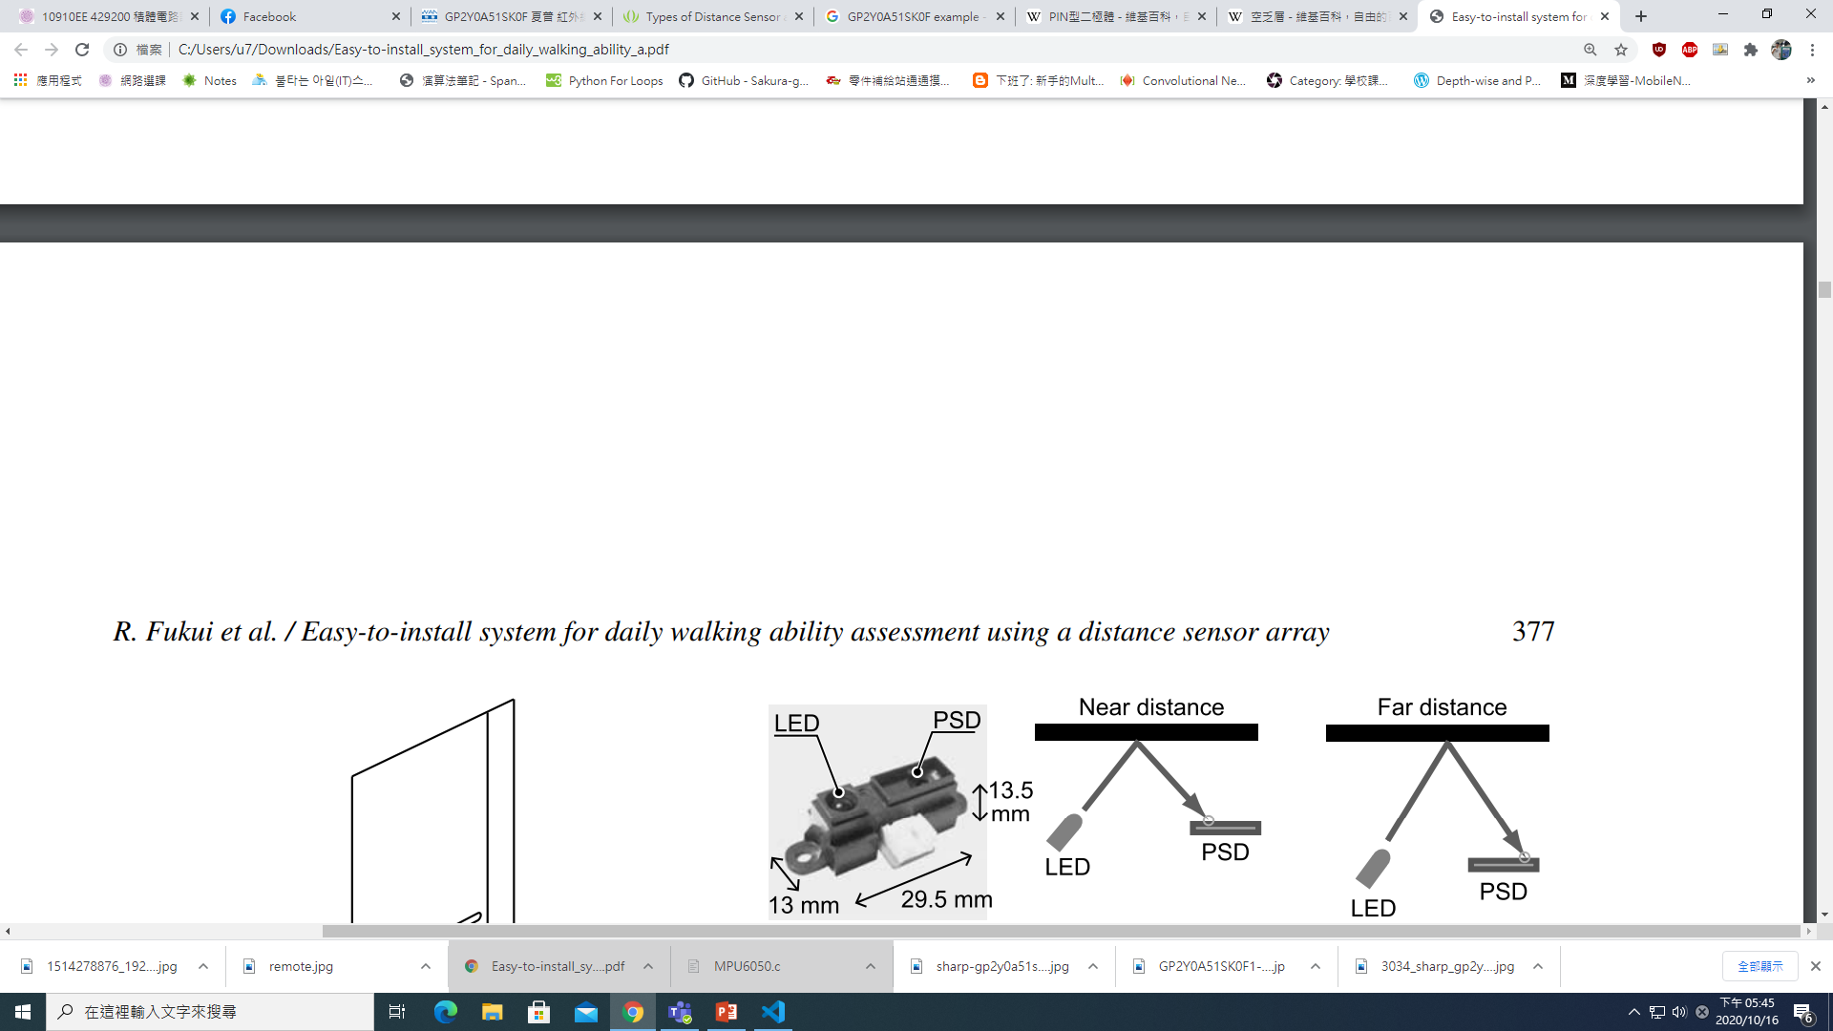
Basic Working Theory
This device outputs the voltage corresponding to the detection distance.

Slide 9
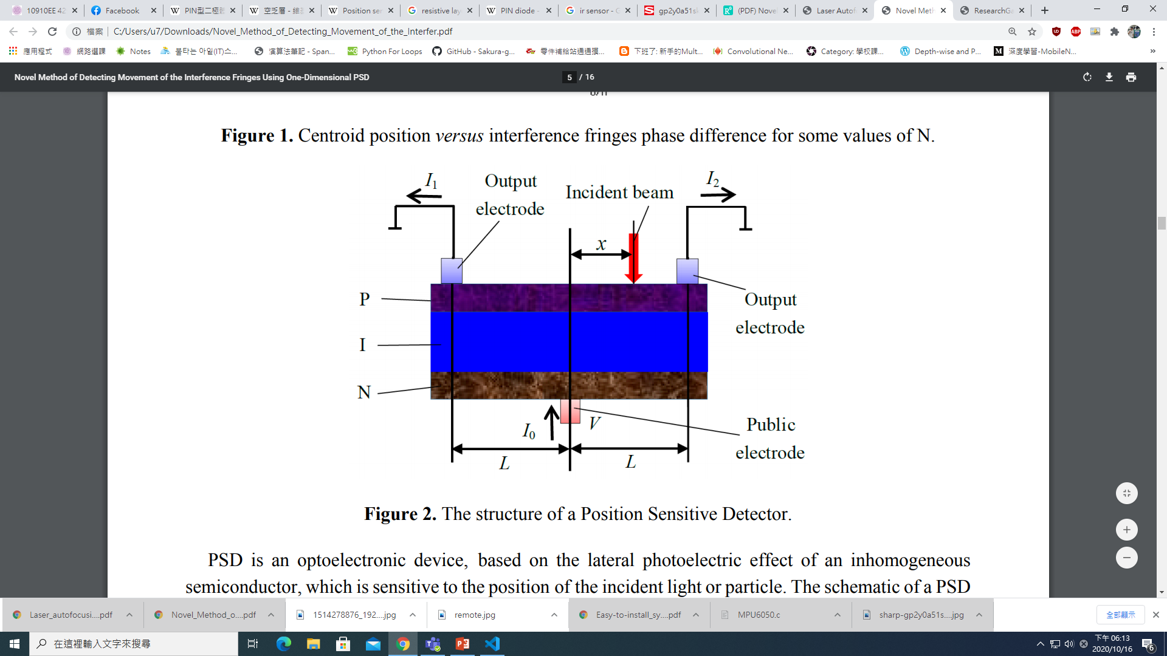
Position Sensitive Detector

Slide 10
Position Sensitive Detector
The two output electrodes receive different intensities, I1 and I2, which are based on the incident beam position x.
The incident beam position x can be calculated with the formula below, and further used to determine the incident light spot distance.
l2
l1
x=L*(I2-I1)/(I2+I1)

Slide 11
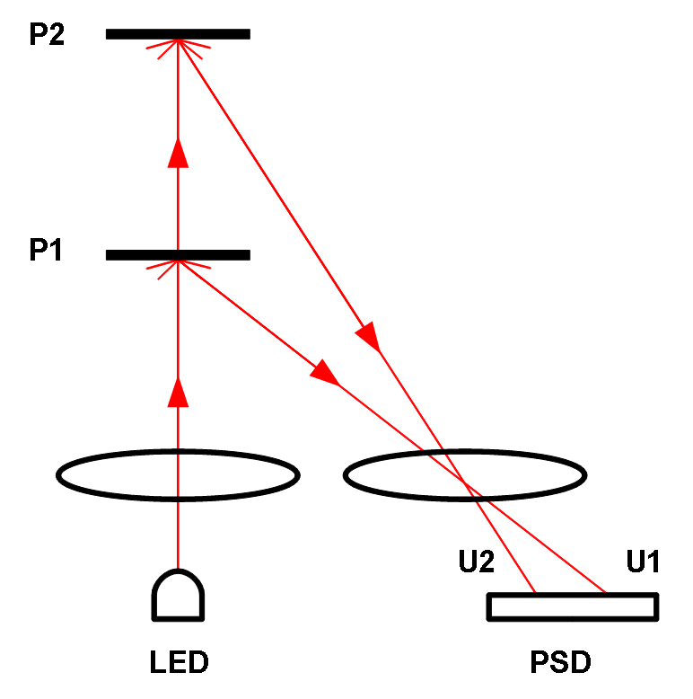
Triangulation Measurement
Angle 2
Angle 1
PSD
X2
X1
The angle between reflective light and PSD can be derived knowing the centroid position of reflective light(X).
The distance between object and device can then be calculated by triangulation.

Slide 12
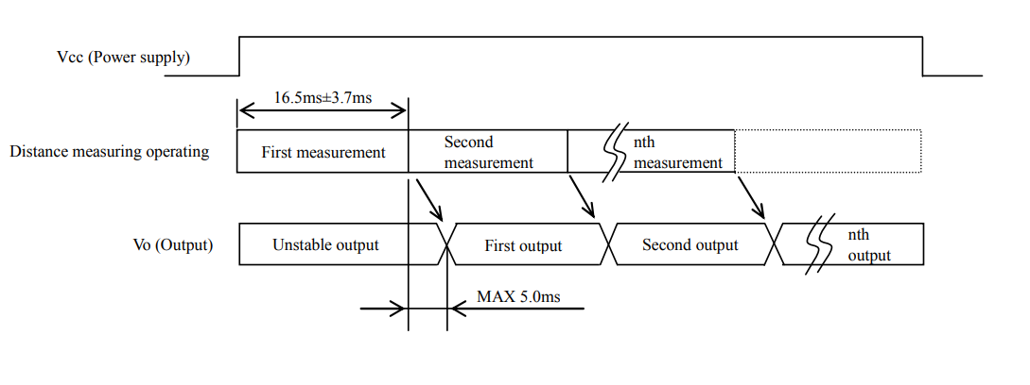
Timing Chart
Measuring cycle 16.5ms
Max output delay 5ms

Slide 13
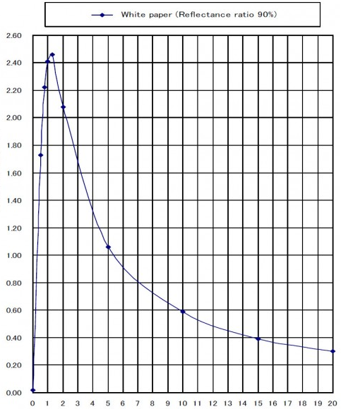
Example of Output
X-axis: Distance to the reflective object(cm).
Y-axis: Analog voltage output(V)
Output voltage drops with greater distance.

Slide 14
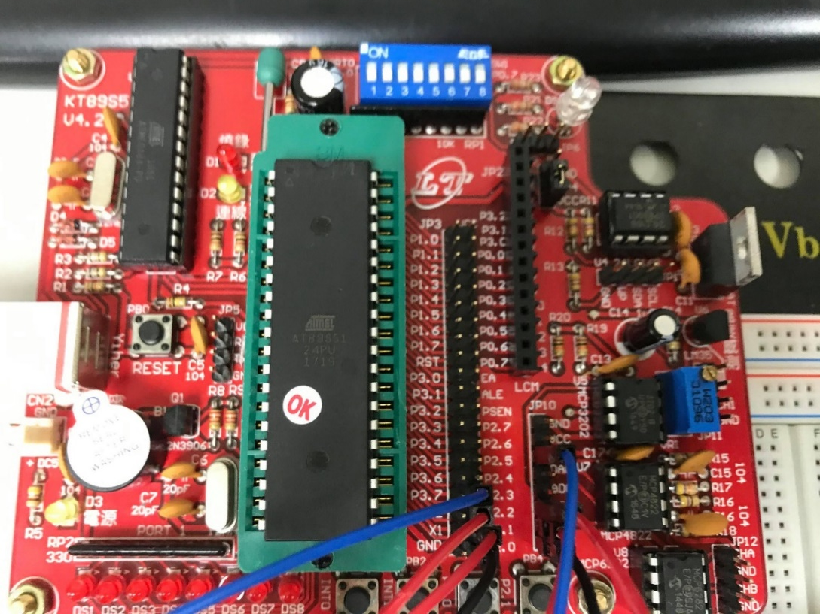
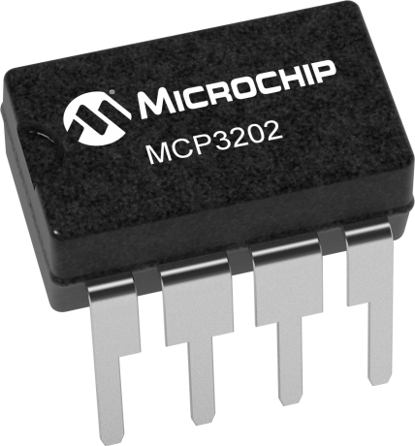
Analog Digital Converter-MCP3202
We need an ADC to convert the analog output from the IR distance sensor to digital values.
MCP3202 is a 12-bit resolution ADC

Slide 15
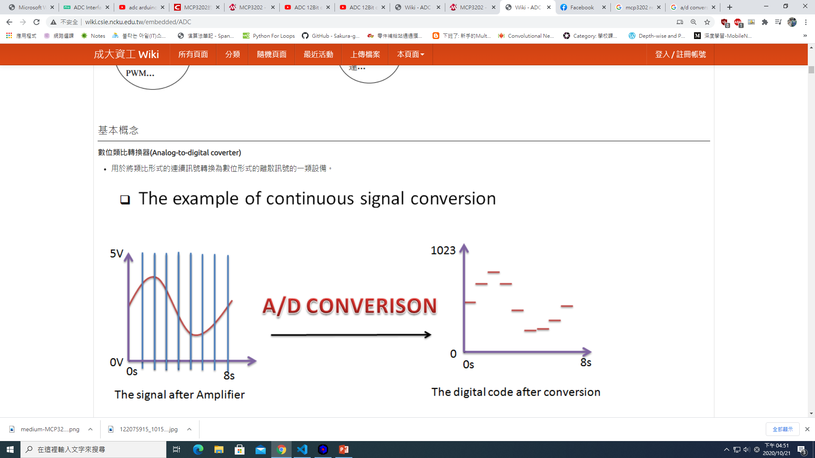
ADC Introduction
4095
A/D Conversion
Sampling rate for MCP3202
  Maximum 100 ksps at VDD = 5V
  Maximum 50 ksps at VDD = 2.7V

Slide 16
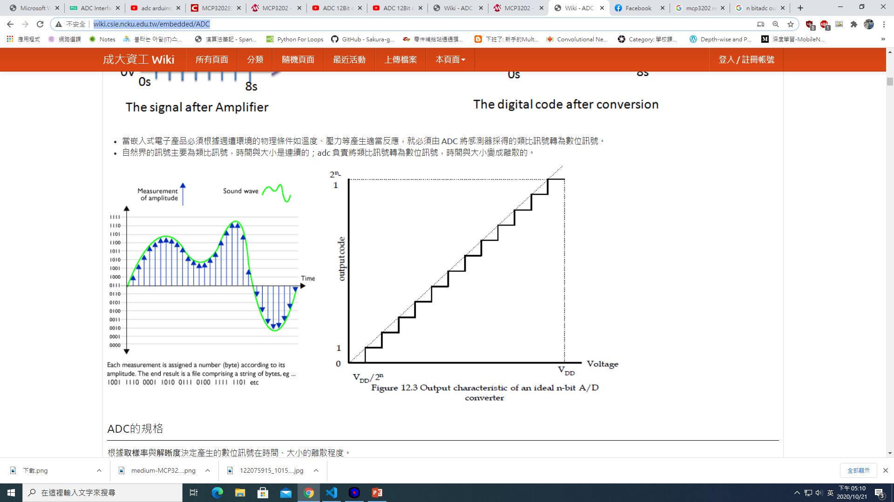
N-bit Output Code
Converted Voltage= Converted Value*VDD/2^{n}-1
2^{n}-1
In our case, n=12
A unit step is VDD/2^{n}
0

Slide 17
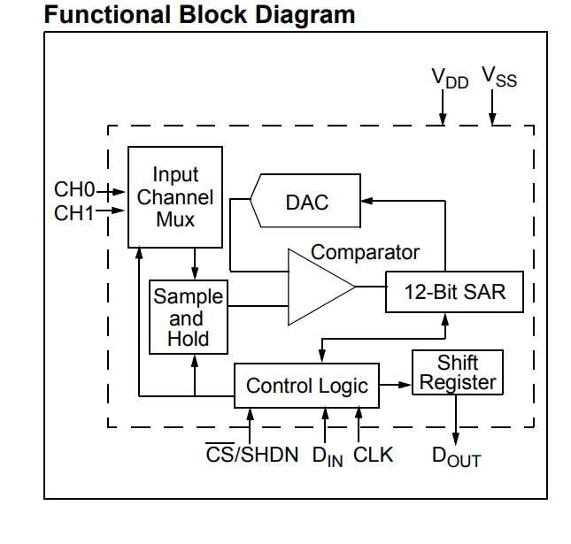
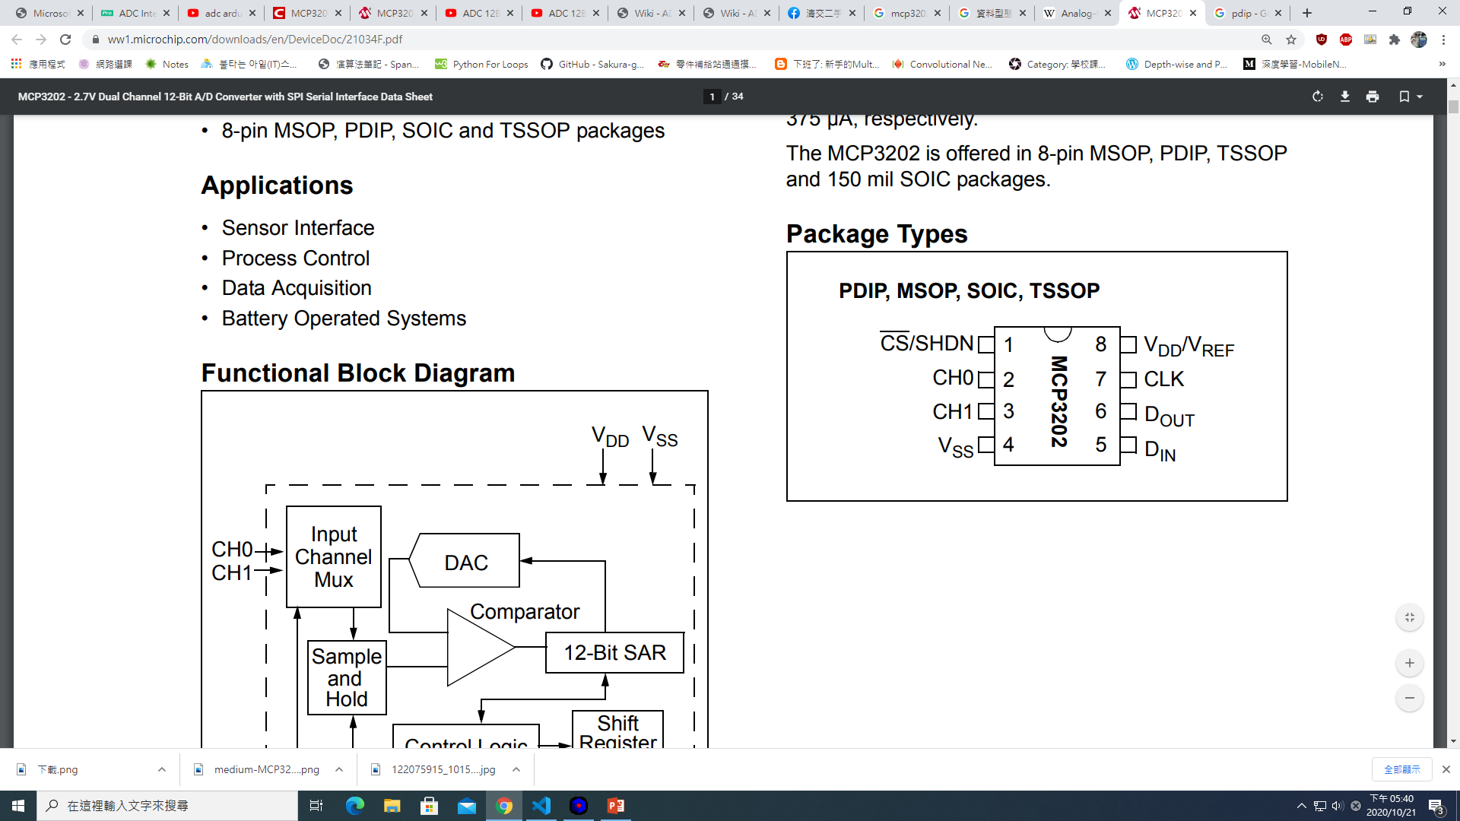
Block Diagram
Using SPI interface, same as MAX7219 in LAB2

Slide 18
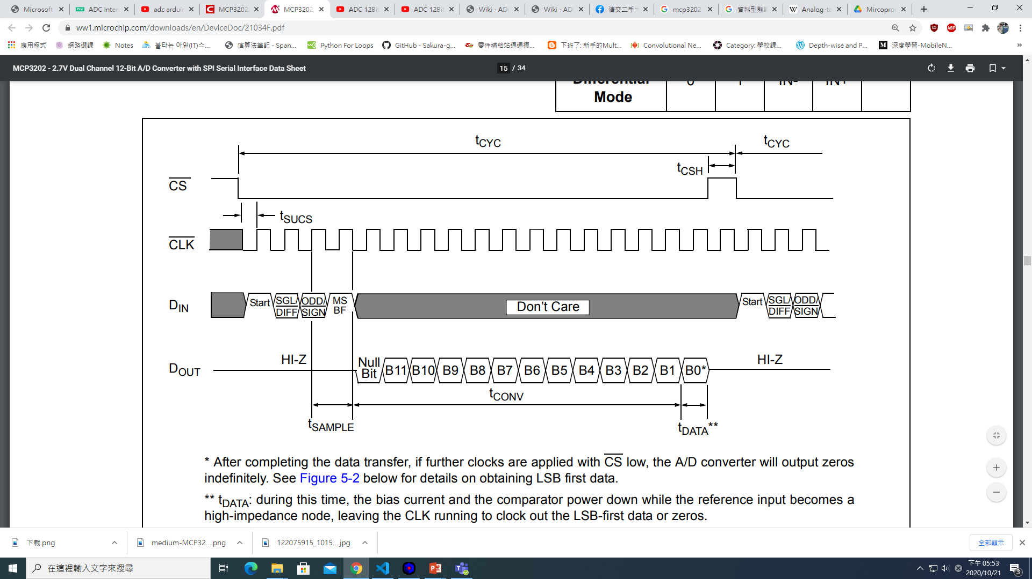
Timing Diagram
Start
The first DIN with CS low consists of a start bit.
Sampling time = 1.5 cycles.

Slide 19
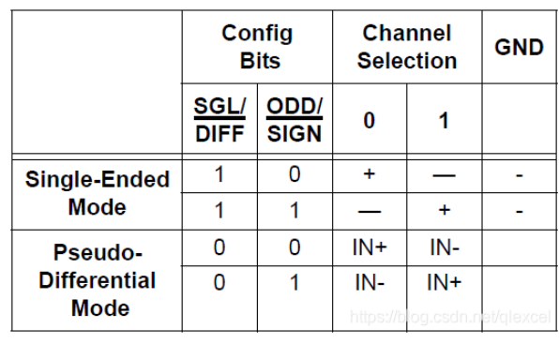
Work Mode
Single-ended(1)/Channel select(0 or 1)
Pseudo-Differtial(0)/Polarity(+ or -)

Slide 20
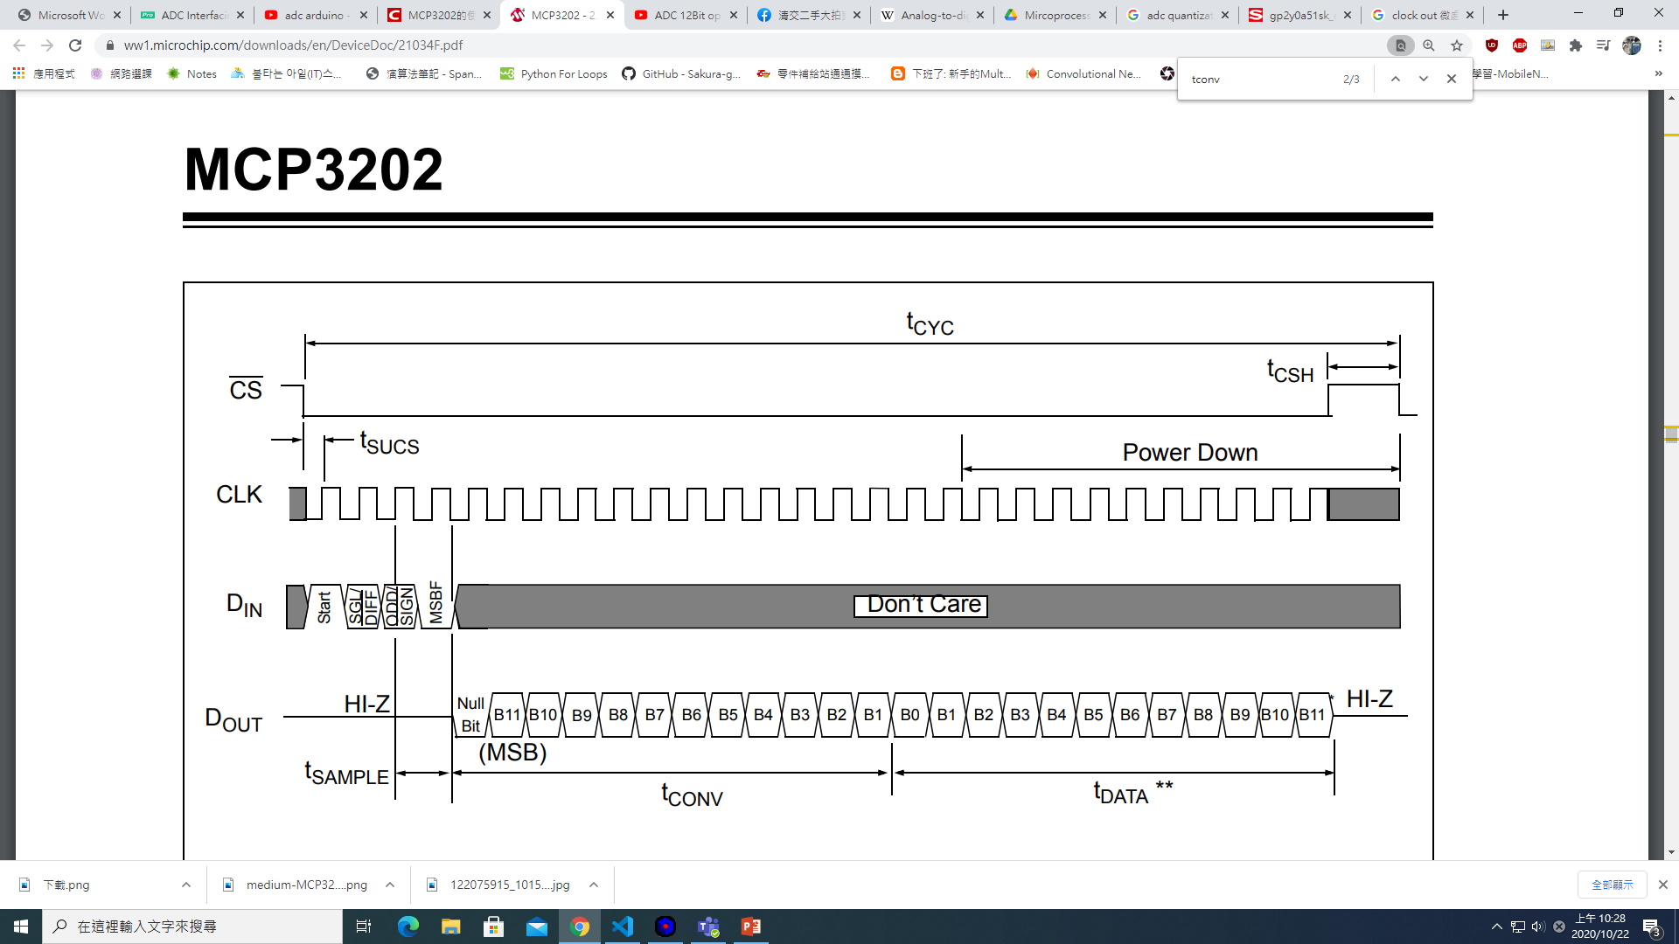
Work Mode
MSBF bit is transmitted and used to enable the LSB-first format.
If the MSBF bit is low, the device will output the converted word LSB first after the word has been transmitted in the MSB-first format.

Slide 21
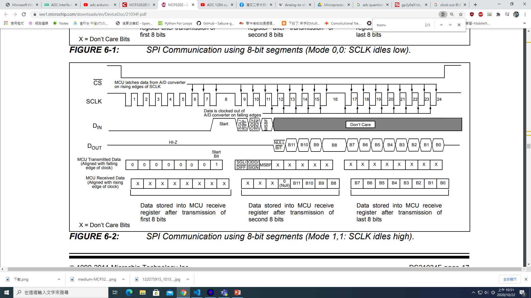
Communicate with 8 bit MCU
Data is transmitted from ADC on falling edges of SCLK.
Data is received by MCU on rising edges of SCLK.

Slide 22
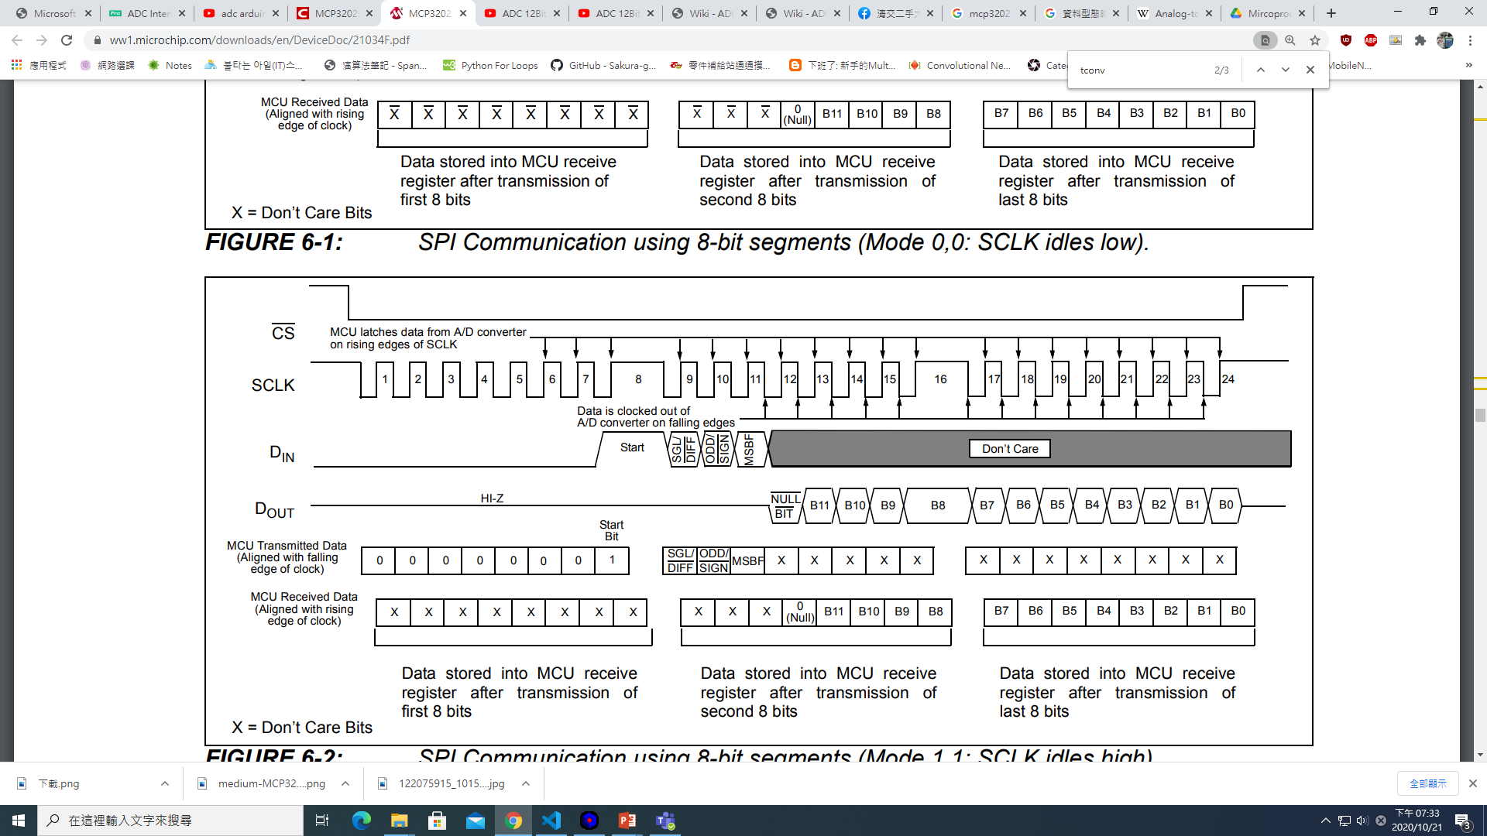
Communicate with 8 bit MCU
1bit start
2bit choose mode+1bit MSBF
1bit null+12bit ADC output
It is required to send groups of 8 bits, how do we deal with it?
In order to get these 17 bits, we need 8*3=24cycles.

Slide 23
8 Bit MCU Transmission Arrangement
First byte transmitted to the A/D converter contains seven leading zeros before the start bit.
This way produces the output 12 bits to fall in positions easily manipulated by the MCU.

Slide 24
8 Bit MCU Transmission Arrangement
Highest order four bits of the conversion
MCU receive buffer will contain three unknown bits until the null bit is clocked out.
Second byte consists of Null bit and the highest order four bits of the conversion.

Slide 25
8 Bit MCU Transmission Arrangement
lowest order eight bits of the conversion
Third byte consists of lowest order eight bits of the conversion.
Easier manipulation of the converted data can be obtained by using this method.

Slide 26
Reference
https://global.sharp/products/device/lineup/data/pdf/datasheet/gp2y0a51sk_e.pdf
https://www.researchgate.net/publication/279171564_Novel_Method_of_Detecting_Movement_of_the_Interference_Fringes_Using_One-Dimensional_PSD
https://ww1.microchip.com/downloads/en/DeviceDoc/21034F.pdf
https://en.wikipedia.org/wiki/Analog-to-digital_converter

Slide 27
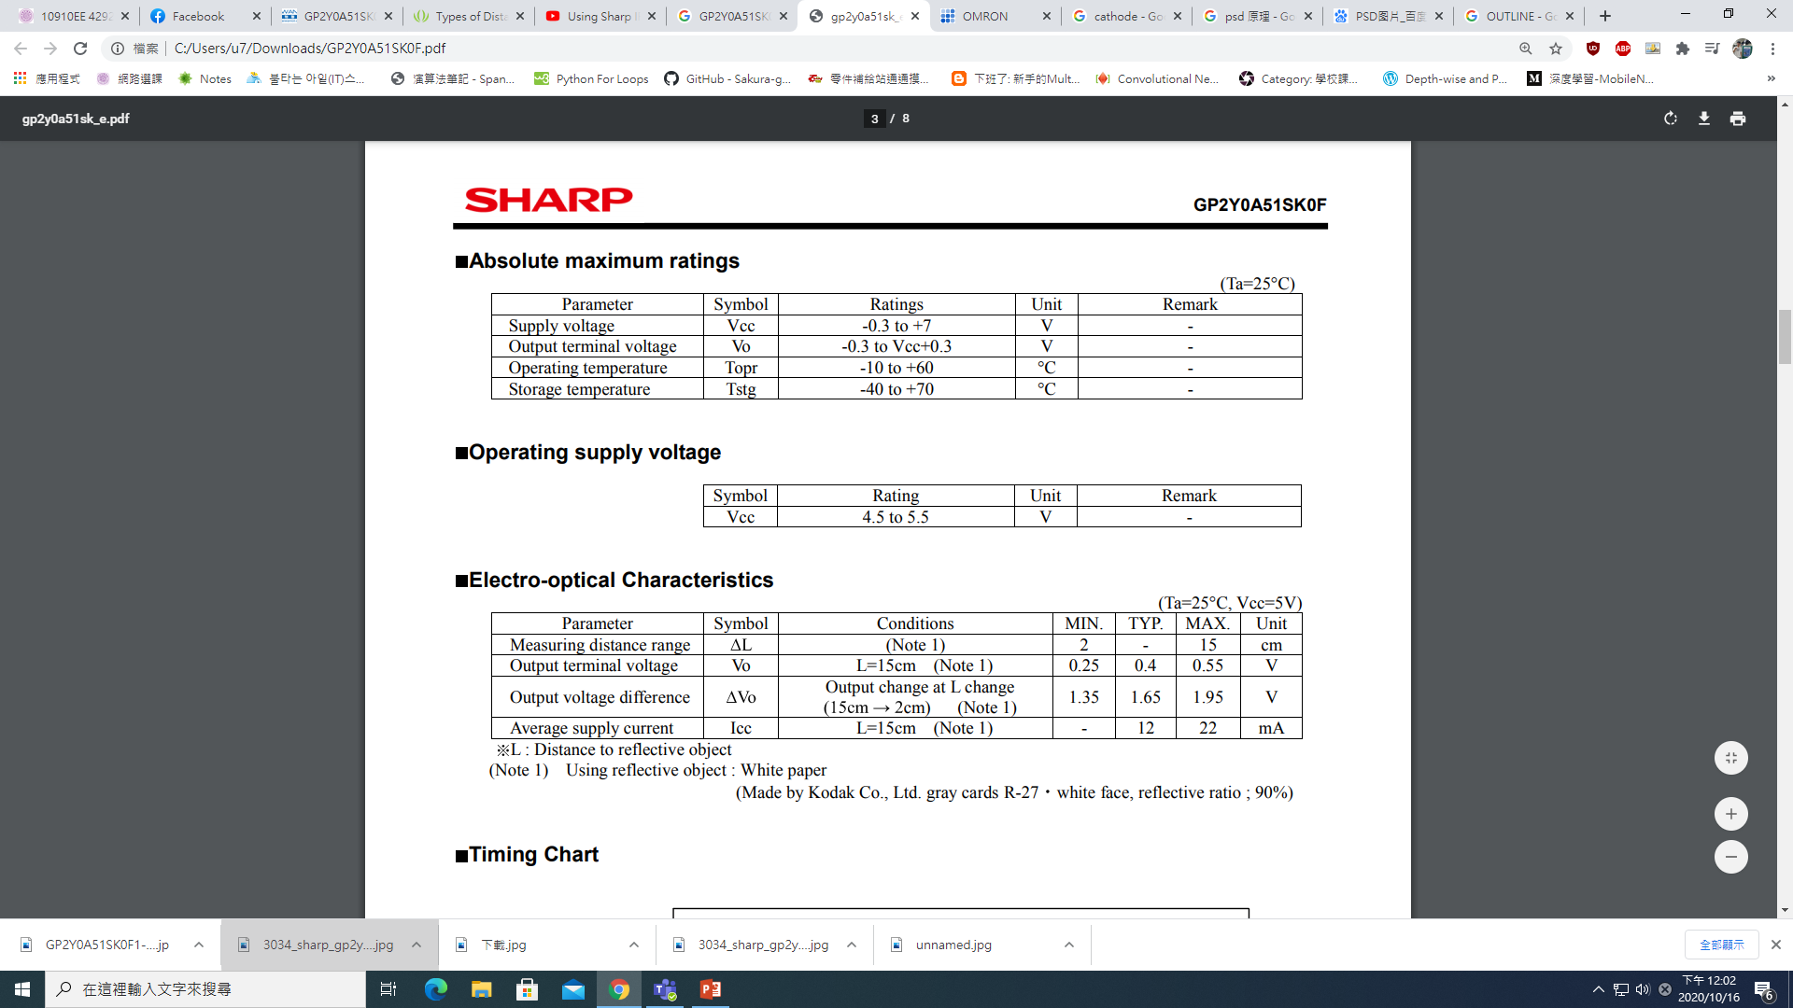
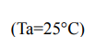
IR Sensor Operating Interval

Slide 28
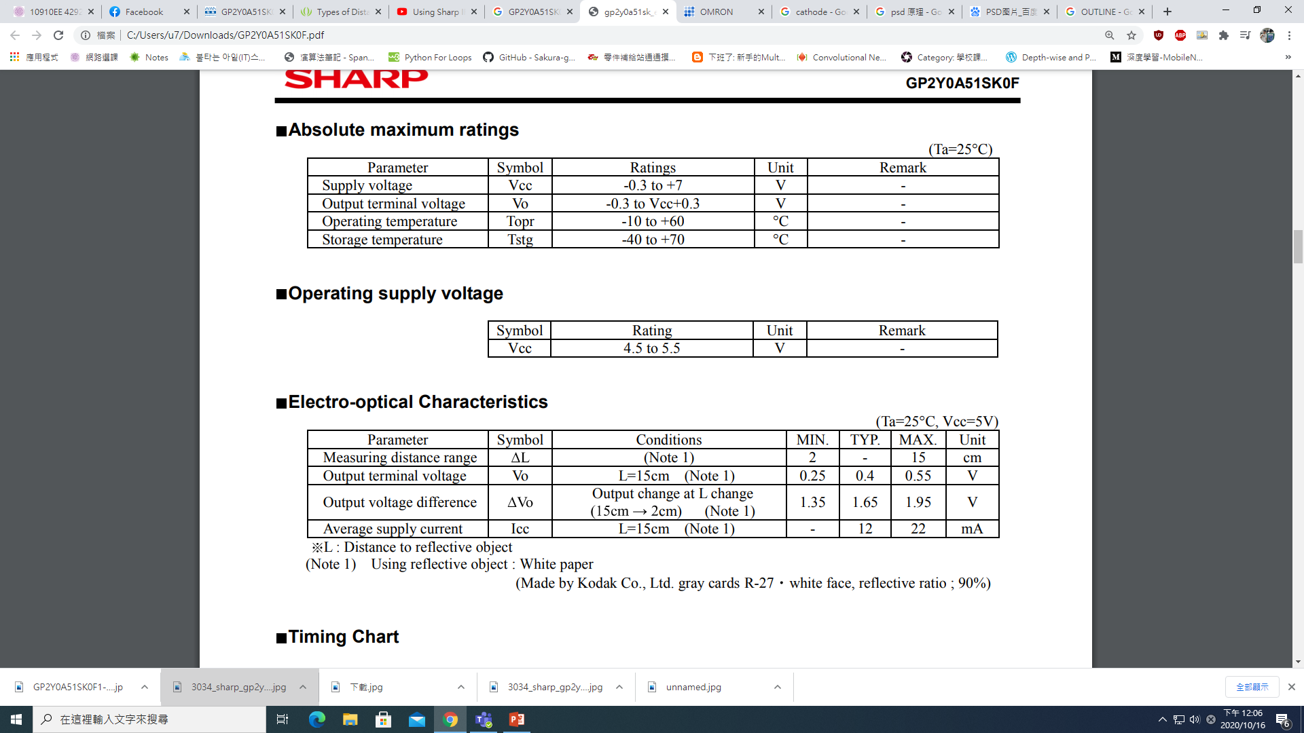
IR Sensor Measuring Interval

Slide 29
Microprocessor Systems
Lab7-2 MLX90614 IR Thermometer
Prof. Ren-Shuo Liu
NTHU EE

Slide 30
Introduction
MLX90614 is an Infrared thermometer for noncontact temperature measurements
MLX90614 is built with 2 chips
  Infrared thermopile detector MLX81101
  Single conditioning ASSP MLX90302

Slide 31
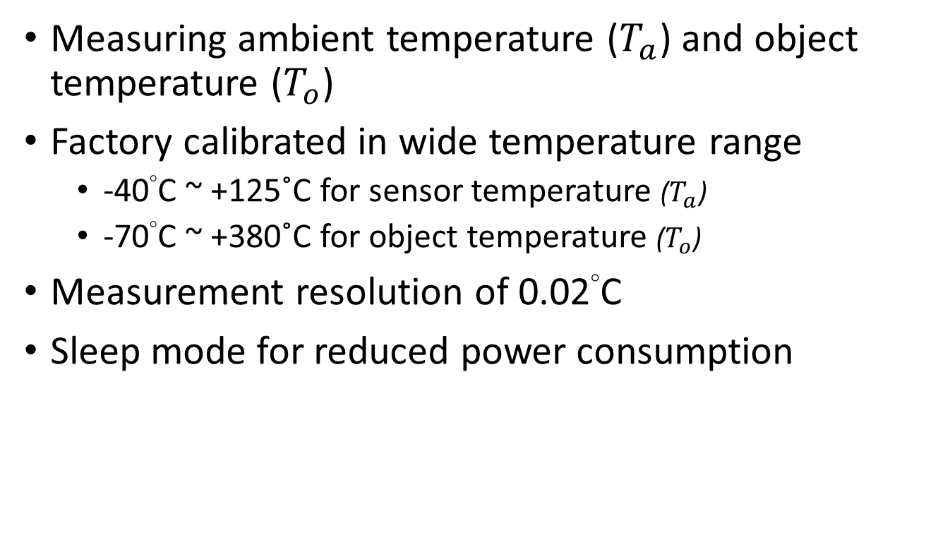
Features
Measuring ambient temperature ($T_{a}$) and object temperature ($T_{o}$)
Factory calibrated in wide temperature range
  -40°C ~ +125˚C for sensor temperature ($T_{a}$)
  -70°C ~ +380˚C for object temperature ($T_{o}$)
Measurement resolution of 0.02°C
Sleep mode for reduced power consumption

Slide 32
Applications of MLX90614
Non-contact thermometer​ (Lab project)
Temperature Measurement of moving objects
Industrial Thermal Gun
Human Body Temperature Measurement
Home/Office Temperature Control
Livestock Monitoring
Movement Detection

Slide 33
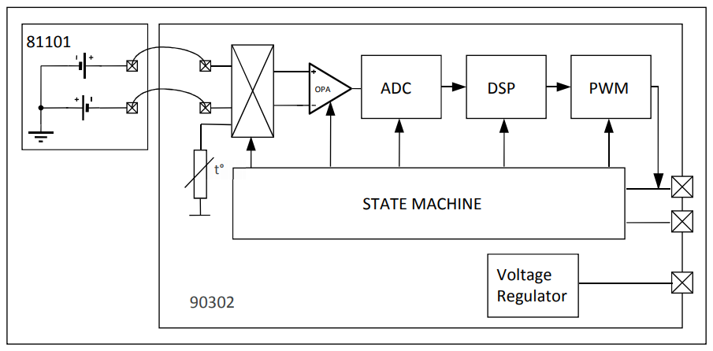
Block Diagram

Slide 34
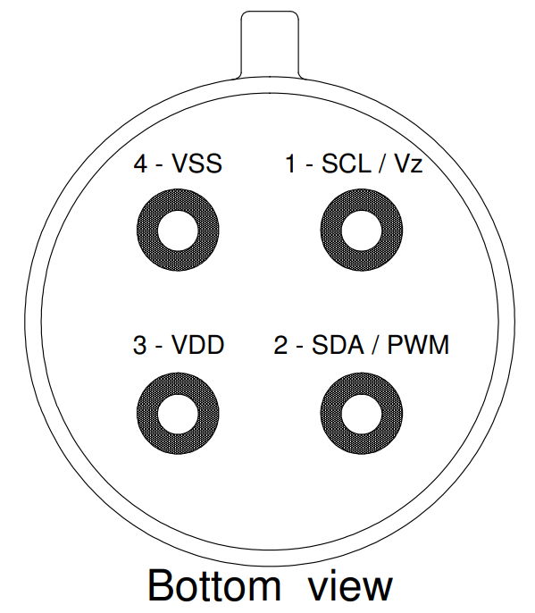
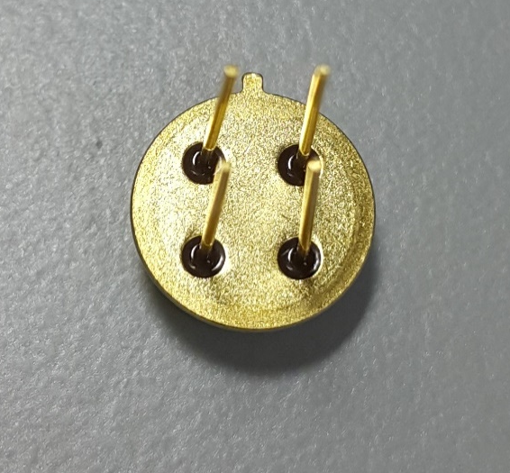
MLX90614

Slide 35
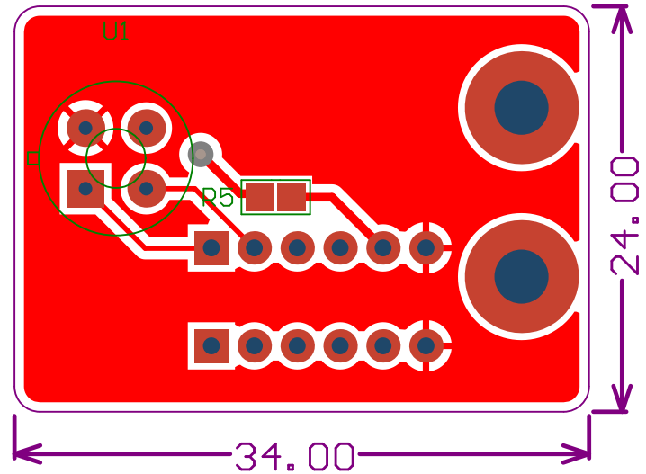
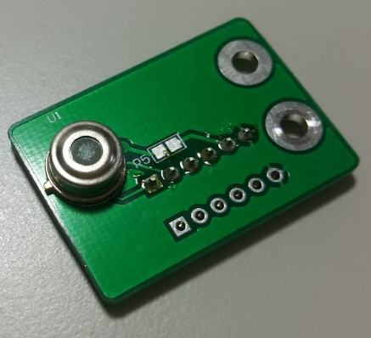
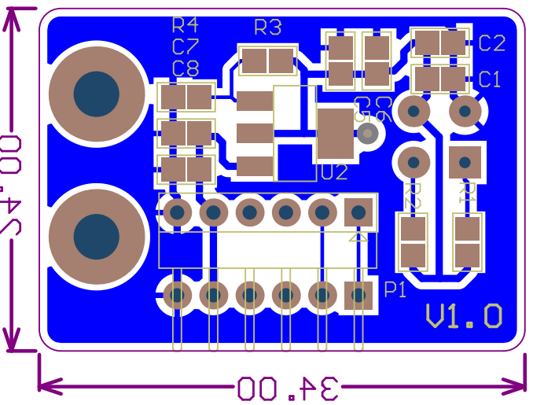
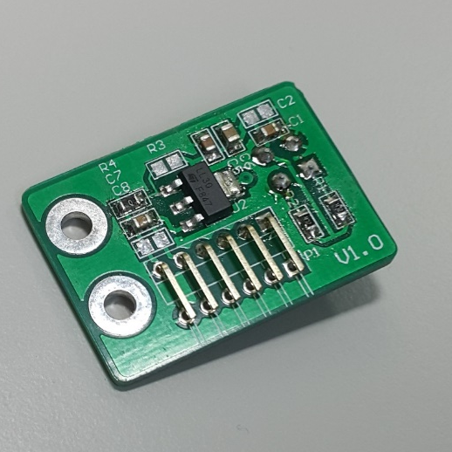
MLX90614 With PCB

Slide 36
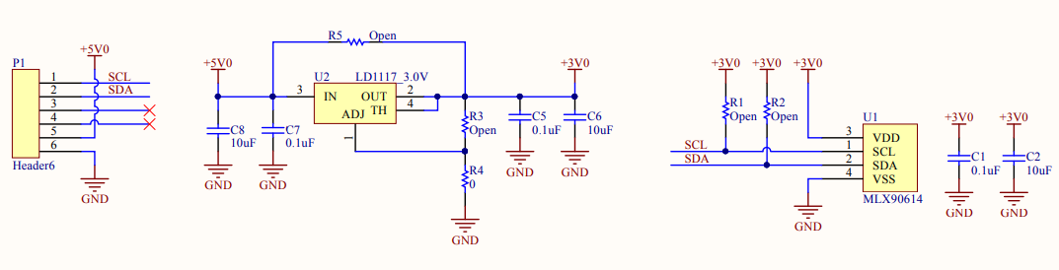
Connection with MCU

Slide 37
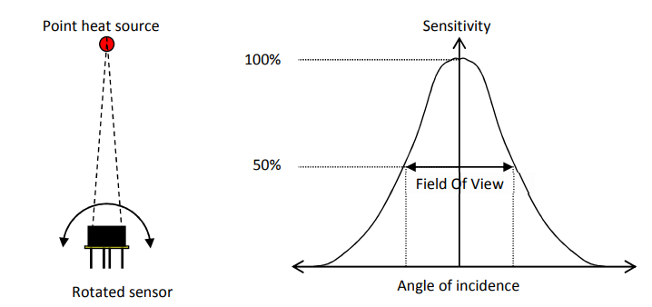
Field of View
How Field Of View For Infrared Temperature Sensors Is Determined
https://youtu.be/vpN-myfTAOs

Slide 38
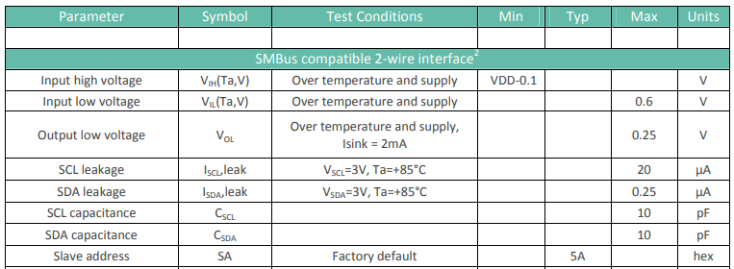
SMBus Compatible 2-wire Interface
Slave address: 0x5A

Slide 39
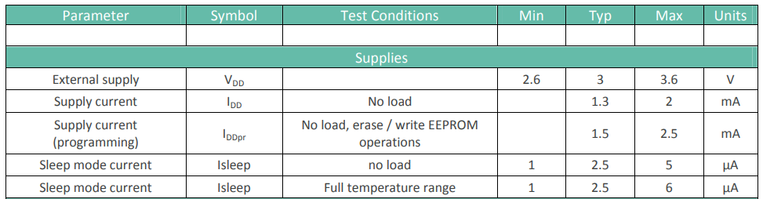
Electrical Specifications
Typical Supply current = 1.3mA
Sleep mode current = 2.5uA

Slide 40
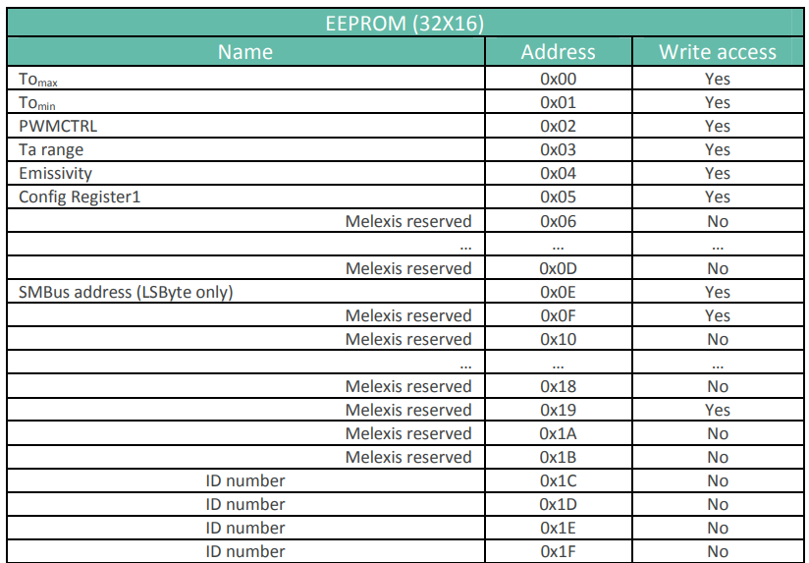
EEPROM
Size : 32x16 bits ( 32 register , 16 bit/register )

Slide 41
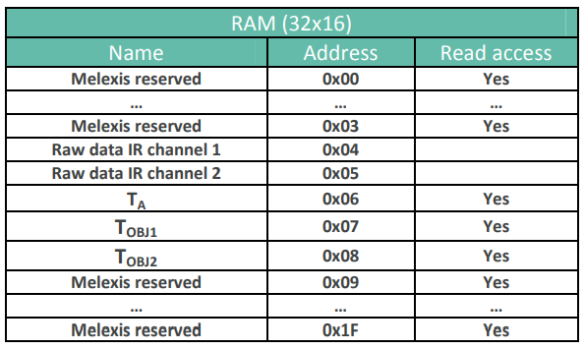
RAM
Size : 32x16 bits ( 32 register , 16 bit/register )

Slide 42
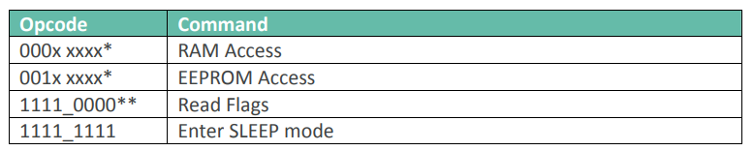
Command
Note *: The xxxxx represent the 5 LSBits of the memory map address to be read / written
Note **: Behaves like read command. The difference is that the read flags does not have a repeated start bit
Five bits correspond to 32 registers

Slide 43
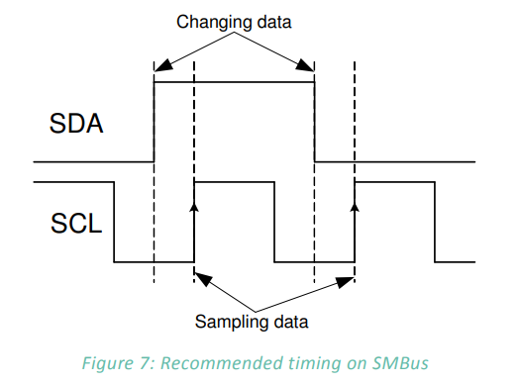
Bit Transfer

Slide 44
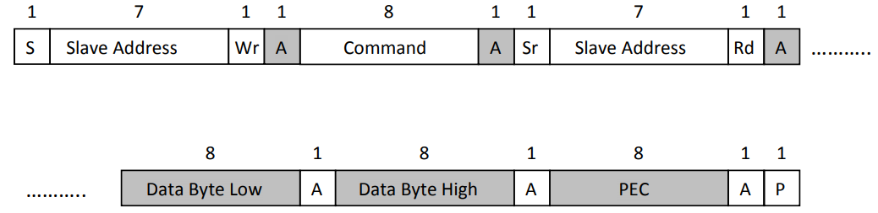

Read Word
Access RAM, read $T_{a}$, $T_{o}$

Slide 45
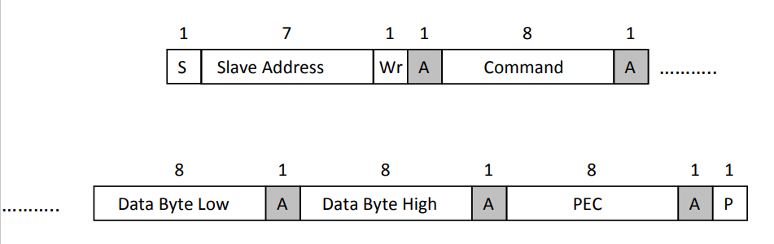
Write Word
Write data in EEPROM

Slide 46
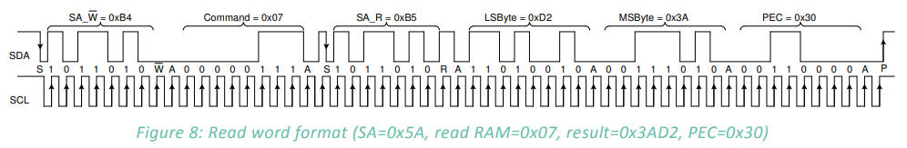
SMBus Communication Example

Slide 47
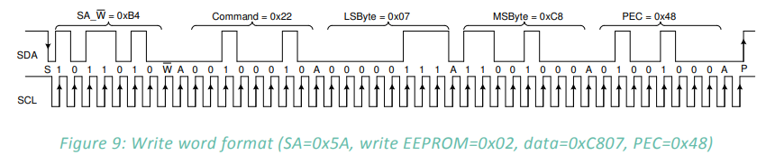
SMBus Communication Example
Command 0x22 = 0010_0010

Slide 48
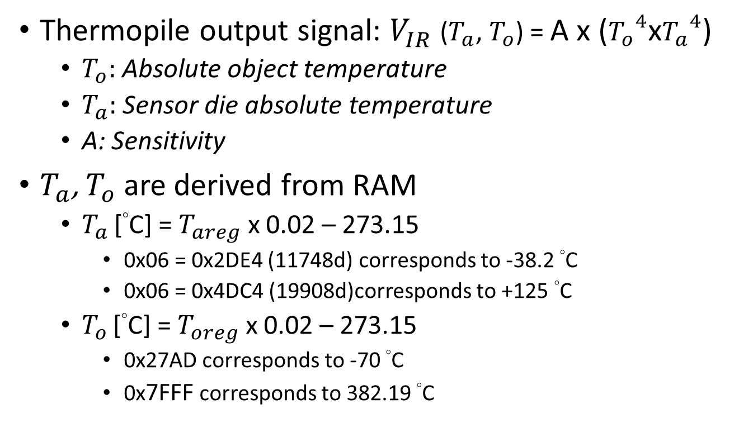
Computation of Ambient and Object Temperatures
Thermopile output signal: $V_{IR}$($T_{a}$, $T_{o}$) = A x (${T_{o}}^{4}$x${T_{a}}^{4}$)
  $T_{o}:$Absolute object temperature
  $T_{a}:$Sensor die absolute temperature
  A: Sensitivity
$T_{a}$, $T_{o}$are derived from RAM
  $T_{a}$ [°C] = $T_{areg}$ x 0.02 – 273.15
    0x06 = 0x2DE4 (11748d) corresponds to -38.2 °C
    0x06 = 0x4DC4 (19908d)corresponds to +125 °C
  $T_{o}$ [°C] = $T_{oreg}$ x 0.02 – 273.15
    0x27AD corresponds to -70 °C
    0x7FFF corresponds to 382.19 °C

Slide 49
Reference
https://www.melexis.com/zh/documents/documentation/datasheets/datasheet-mlx90614
https://www.mouser.tw/datasheet/2/268/mic5270-1891236.pdf

